Slide 1
Séquence 5 – Seconde Singularité et solidarité: BULLYING Final project: You made a friend on Facebook, he/she is Canadian and is about your age. He/She told you he/she is being bullied at school by one of his/her classmates (insults, threats, physical violence). You are going to send him/her a Facebook message in which you will give him/her advices to end this unbearable situation. (Give at least 2 advices and end your message with comforting words).

Slide 2
Bully ad http://www.youtube.com/watch?v=nWJut7KQhI4
Séance 1
Vidéo:
Bully gay
http://www.youtube.com/watch?v=Fwfl1IvGEnw

Slide 3
About the video:
Where does the scene take place ?
Who can you see ?
What happened ?
Why ?

Slide 4
Unit 5 – Singularité et solidarité Bullying
Video:
HW: Imagine a short dialogue between the boys that would follow what happened in the video.
Notes:
Voix passive
Present perfect

Slide 5
Let’s act!
Séance 2
Act out your dialogue.
What impression do you have?

Slide 6
Images
Séance 3

Slide 7
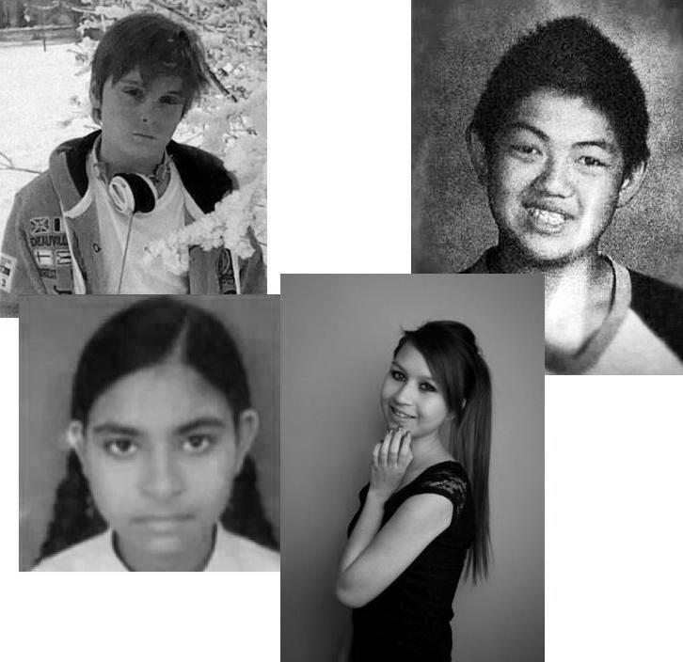
Mattéo
David
Priyanka
Amanda Todd

Slide 8
Texts and audio
Group 1: Amanda Todd
Group 2: David
Group 3: Priyanka
Recap what you have read/heard for the other groups.
Now, what is the link between these people?
Notes:
Vocab: unlike; differ from; compare to; ethnic; laught at; billied; bully; tease; scapegoat; belong to…
Gram: advice (should, had better…, would rather…, ought to,…); comparison

Slide 9
Let’s recap on the kids
Images:
Describe/Comment
React to their story (what is your opinion?)

Slide 10
Defining bullying Brainstorming
Séance 4
Bullying:
Notes:
Types?
Victims? Targets?

Slide 11
Texts
What is bullying?
Types of bullying:
HW: Review your vocabulary and agumentation for your test next time (EE)

Slide 12
Test (100 words)
Séance 5
Do you think teenagers are tolerant nowadays? Why? Why not?
OR
Do you think our society advocates tolerance and respect? Justify.

Slide 13
BA du film « Bully » divisée en 3 parties
Séance 6 en médialangue
Group 1: ‘Bully 1’
Group 2: ‘Bully 2’
Group 3: ‘Bully 3’
Watch and take notes to explain what you saw and heard (what? Who? where? When? Why?)
Notes:
Present perfect (he has been…)

Slide 14
What kind of bullying did you see ?
What behavior can help ?
HW: List all the different behaviors that you think can help stop bullying.
Review all your vocabulary for next class test!

Slide 15
Help / Advices
Séance 7
Videos:
‘Walk away’ http://www.youtube.com/watch?v=_sxr9N1FQbo
Watch the video and explain what is happening? What do you think about it? What is the message?
‘Being a friend’ http://www.youtube.com/watch?v=G2lKP4KLNGk
Part 1?
Think about the consequences of these acts?
Part 2?
Part 3?
Do you see solutions to stop bullying from happening?
Notes:
Walk Away (stop video bf the end)
Being a friend (where? What? => hypothèses (may have seen/been…)
Vocab: armful; unconsiderate

Slide 16
Changing things
Videos:
HW: Review what we have done since the beginning of the unit to be prepared for your final task for next class
Notes:
TE

Slide 17
Your final task
Séance 8 en médialangue
You made a friend on Facebook, he/she is Canadian and is about your age.
He/She told you he/she is being bullied at school by one of his/her classmates (insults, threats, physical violence).
You are going to send him/her a Facebook message in which you will give him/her advices to end this unbearable situation. (Give at least 2 advices and end your message with comforting words).

Slide 18
